Slide 1
WORD CRUSHER
Code Ninjas:
Renee Messick
Sapana poudel
Chris Coulon
Marisha Hoza
June 28, 2019

Slide 2

Renee Messick
Renee is a software engineer apprentice just trying to get everything she can from life. All she really wants to do is hang out with her tiny monster dog and binge watch tv shows while coding.
Bullet points for your 60 seconds

Slide 3
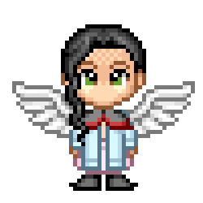
Sapana poudel
Sapana just wants to fly to the land of coding, play inside the loop, swing by the function, and spend some times with new angles inside objects. Then she wants to come back to her real world and spend more time with her little angel SERENA!!! She loves nature......
Bullet points for your 60 seconds

Slide 4

Chris coulon
Chris is the hero that we do not deserve, but also the one that we do not really need… His prowess at crushing
words is outstripped only by his uncanny ability to know just what to say in any conversation only a mere ten
minutes after they have happened. He is also fond of… justice.
Bullet points for your 60 seconds

Slide 5
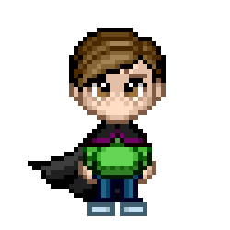
Marisha hoza
Marisha is an apprentice level Wizard. She draws most of her power from her cat familiar, but strives to use this energy only for squashing code bugs and crushing algorithm problems. When not fighting against programming enemies, you can find Marisha outdoors, painting, or playing with her familiar.
Bullet points for your 60 seconds

Slide 6
Problem domain
The initial concept of our project was a game that would test knowledge in different categories in an entertaining environment. The intent was to pull from all the major concepts covered in 201, utilizing HTML, CSS, and JavaScript.
We started with an minimum viable product (MVP) of one topic category, speed typing, and basic game functionality. By the time we finished with MVP we decided to expand upon the one topic and optimize functionality and the display rather than add additional categories.

Slide 7
Implementation
Multi-level game
Each level environment changes, different background, more challenging, background music.
Levels/displays to be interactive: moving/dynamic, user experience.
Characters chosen by user and carried over through levels and to the leaderboard.
Leaderboard: ranking of scores pulled from local storage
Use of canvas to create environment of each level and incorporate GIF to make them seem more dynamic.

Slide 8
Go to the project
Cluescavenger.com
Do a walk through, have fun, change things, make new users, etc.

Slide 9
Slides go here
GIFs on Canvas
Bubbling leaderboard
Arrays of words
Not hitting enter
Put pics here of your github project board (s).
Pics of cool code blocks
Pics of cool graphics you made in photoshop
etc

Slide 10
Some Challenges
Limiting project scope: interactive words, additional categories.
Moving background
Checking user input
No interwebs

Slide 11
Wins
WALL OF DOOOM
Group programming
Test user group

